Slide 1
Week 4 – Be Greedy!
Remco van Alen, 507276
Bas van Summeren, 479334

Slide 2
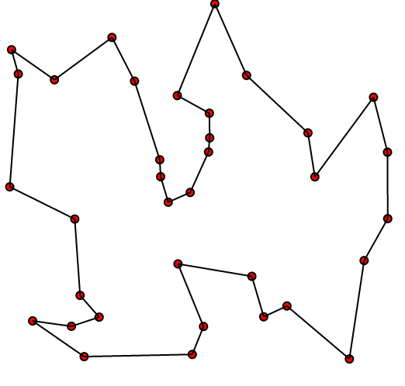
De opdracht
Design an algorithm for a greedy approach to solve a graph problem.
Traveling Salesman Problem or Minimum Spanning Tree

Slide 3
De uitvoering
Alle randen berekenen
Langste waarden verwijderen
Deze methode is de reverse van de Kruskal Methode: Reverse-Delete
Randen sorteren op lengte

Slide 4
Het resultaat
public class Edge implements Comparable<Edge> {
@Override public int compareTo(Edge o) { return (int) Math.round(distance - o.distance); } public boolean equals(Object other) { if (other instanceof Edge) { Edge o = (Edge) other; return o.isEdge(nodes[0], nodes[1]); } else { return false; } }
}

Slide 5
Het resultaat
boolean safeToDelete(Edge toRemove) { if (toRemove.getFirst().amountOfEdges() <= 1
|| toRemove.getSecond().amountOfEdges() <= 1) { return false; } else { for (Edge current : edges) { if (! current.equals(toRemove) &&
hasPathWithout(toRemove.getFirst(), toRemove.getSecond(), toRemove)) { return true; } } return false; } }

